Slide 1
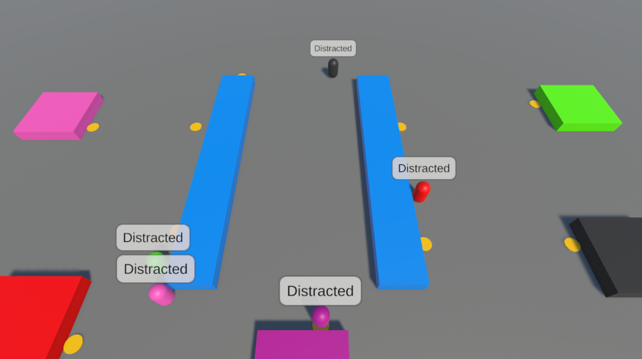
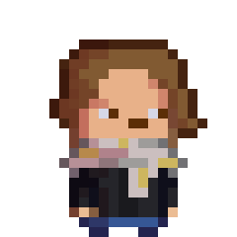
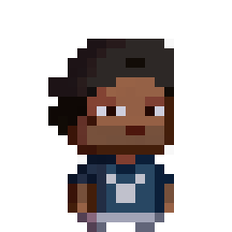
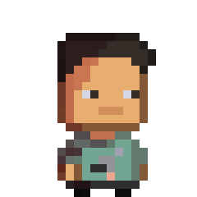
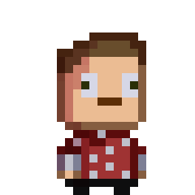
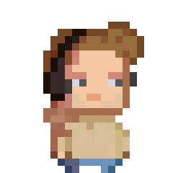

FIVE GUYS
High Concept:
Oversee a team of 5 game developers, as they work to create a game in 2 days. The problem? These are the most unfocused team alive, and will constantly get distracted and it’s your job to wrangle them back to their desks and do their tasks.
Achieved Today:
Created 2D and 3D assets for the game
Created character behaviour and interaction
First prototype finished.
To Achieve Tomorrow?:
expanding upon base gameplay
juicing up game visuals and presentation
playtesting

